Slide 1
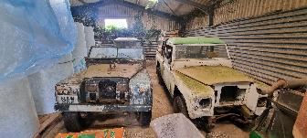
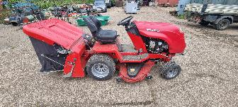
ONLINE TIMED AUCTION
Vehicles, Garage & Horticultural Equipment
Starts: Wednesday 10th July at 12 noon
Finishes: Monday 15th July from 12 noon
Approx 400 Lots to Include:
5 x LWB & SWB Land Rovers & Spares, Garage Equipment, Welders, Near New Eurotek Wheel Balancer & Tyre Changer with Tyres, Howard Price Self-Propelled Gang Mower, New & Used Garden Lawnmowers, Garden Strimmers, Blowers & Hedge Cutters. (Makers include Etesia, Grillo, Stihl, Countax, Mountfield, Honda, Hayter)
Indian Stone, Bricks, Slates & Paving. New Timber, Posts, Edging & Feather Boards,
2017 4Ton Four Post Garage Lift, Heavy Duty Racking.
2012 Peugeot Transport Van with Beaver Tail.
2003 Iveco Dailey Unijet Van with Cherry Picker/Access Platform
2017 Mercedes Sprinter Van, Twin Axle Ifor Williams Plant Trailer
on behalf of W & A C Brooke-Clarke
Medbourne, Leicestershire

Slide 2
Agricultural & Development Consultants, Chartered Surveyors, Auctioneers & Estate Agents | www.bletsoes.co.uk | 01832 736757

